Slide 1
C#11
<PropertyGroup>
<TargetFramework>net7.0</TargetFramework>
<LangVersion>preview</LangVersion>
</PropertyGroup>
@kevinderudder

Slide 2

@kevinderudder
: freelance fullstack developer
: trainer and coach
:

Slide 3
Goal
Goal is to get you started with C#11 and .NET7
The language
The frameworks

Slide 4



⏰ 8 november 2022

Slide 5
Standard-term support
⏰ 8 november 2022
Unified, modern, simple
and fast
Notes:
Microsoft has introduced .NET version 7 with an STS (standard-term support) or the shorter supported version providing only 18 months of support. Microsoft introduced the STS version this year because it already mentioned in 2019 that it would release a new version of .NET every year around November. But, considering the new official .NET 7 features and updates, it still brings a significant number of changes and .NET 7 performance improvements for the Users. Given below are 17 noteworthy differences between .NET 7 vs .NET 6 are as follows:
While .NET 6 was released by the end of 2021, it did not complete unification and lacked certain key components. The new version of DotNet will allow developers to create a wide range of web, mobile, and desktop apps, using the same Base Class Library, compiler, and runtime.

Slide 6
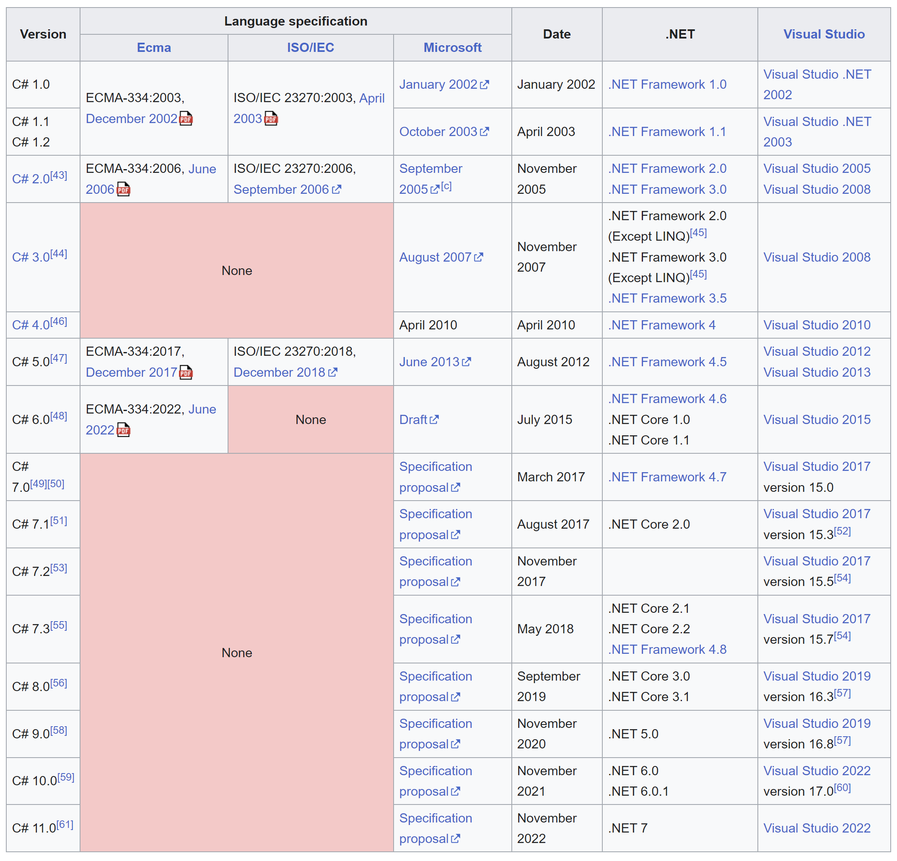
History

Slide 7
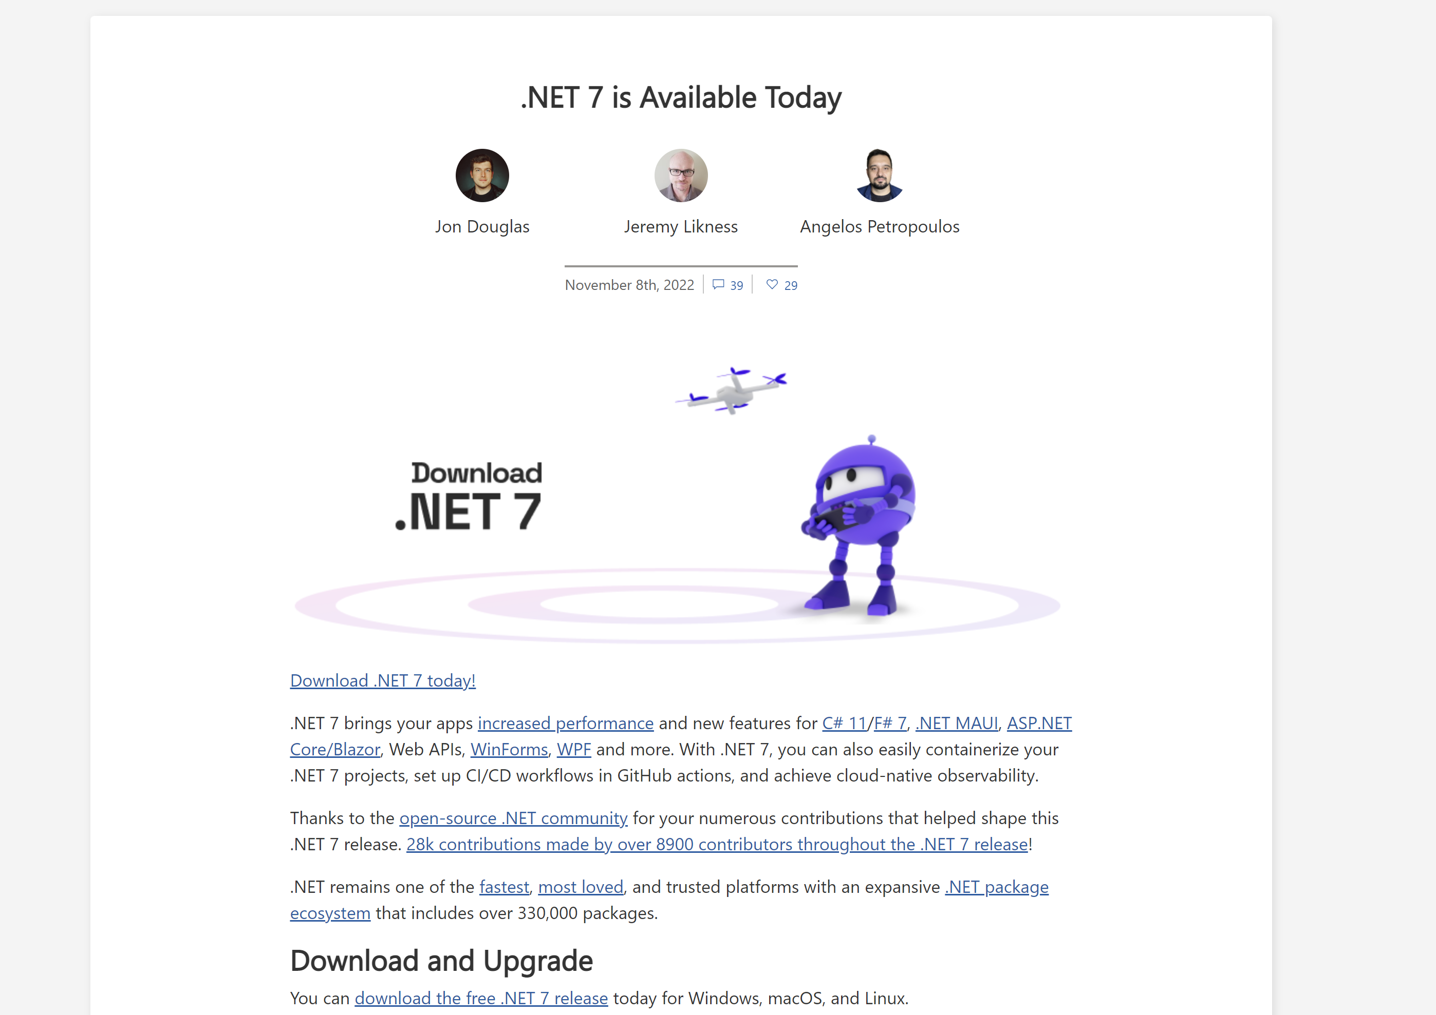
https://devblogs.microsoft.com/dotnet/announcing-dotnet-7/
Notes:
Overlopen en tonen

Slide 8
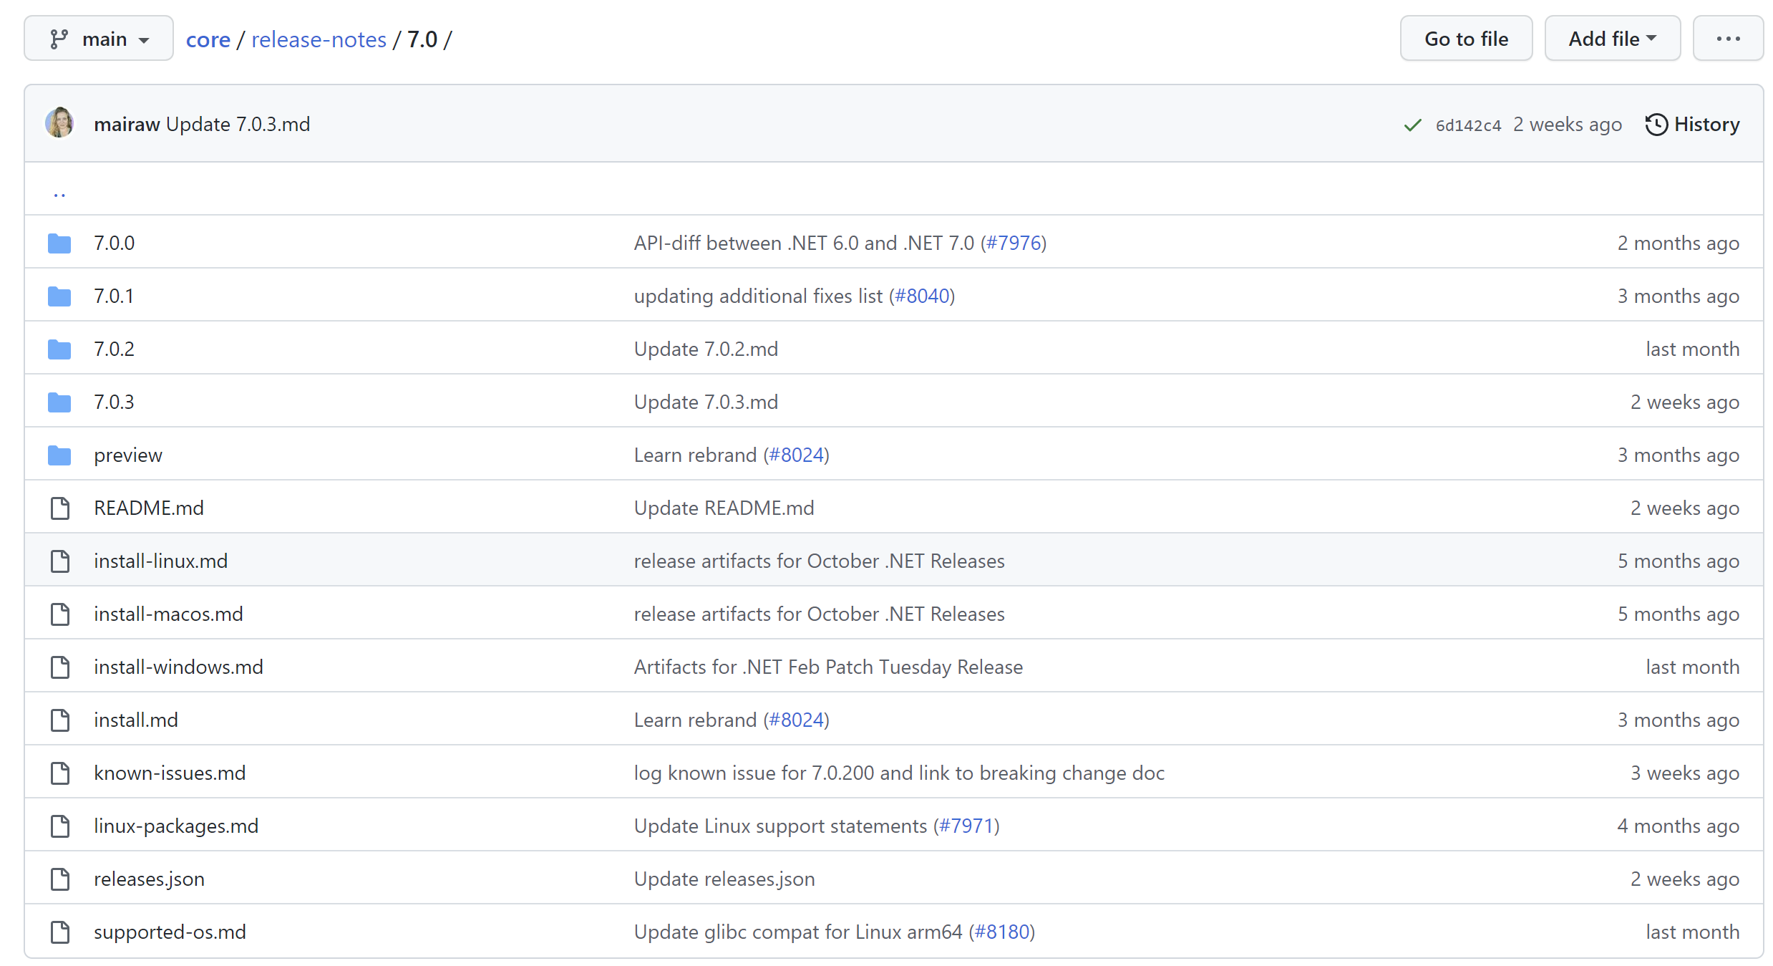

Slide 9


Slide 10
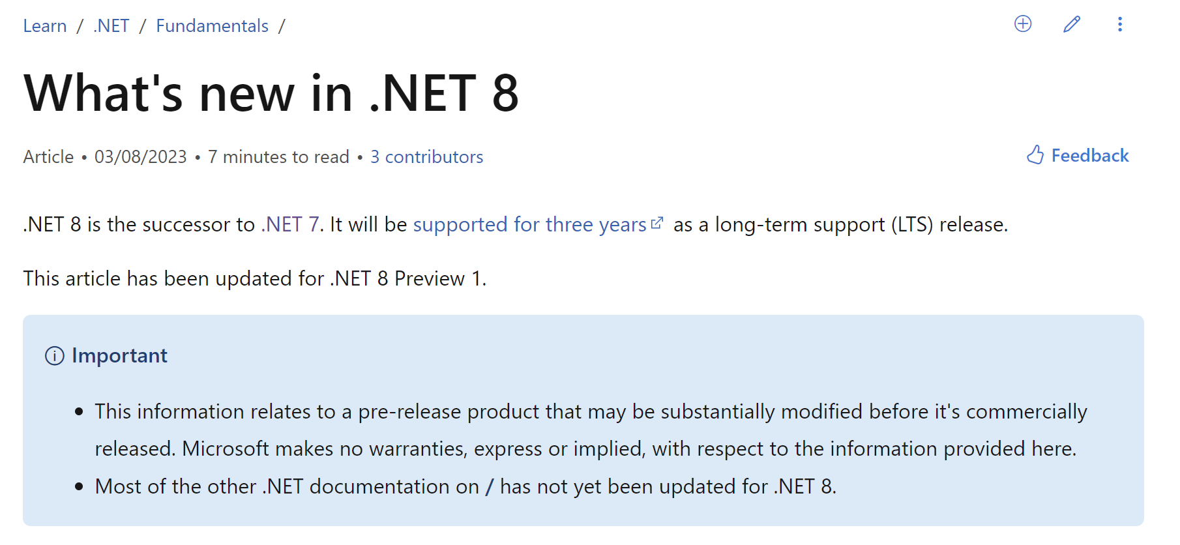

Slide 11
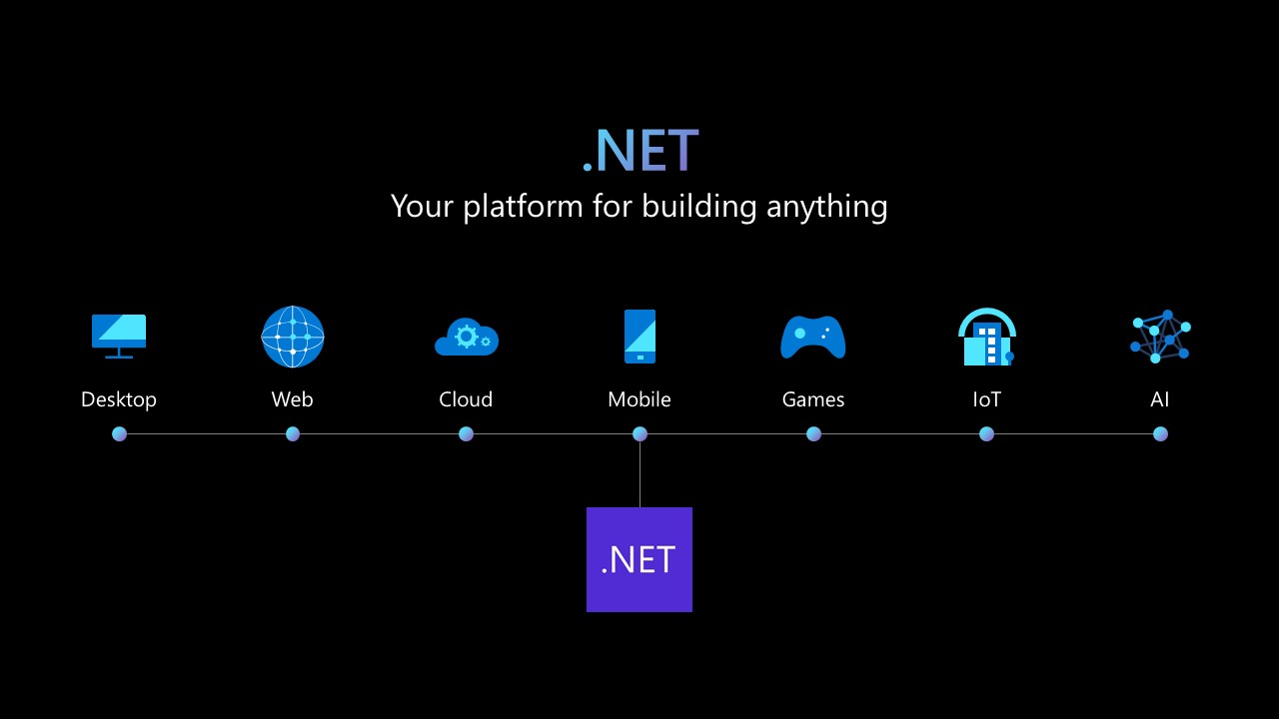
Notes:
The new .NET will focus on better support for cloud-native scenarios, as well as tools to help developers upgrade legacy applications. Morever, it will enable developers to simplify the development experience through seamless functionalities of containers.

Slide 12
📖
https://learn.microsoft.com/en-us/dotnet/core/whats-new/dotnet-7

Slide 13
.NET Focus
Performance
All features are designed with performance in mind
https://devblogs.microsoft.com/dotnet/performance_improvements_in_net_7/
https://devblogs.microsoft.com/dotnet/performance-improvements-in-aspnet-core-7/
.NET is designed for cloud-native applications.
Simpler than ever
Built-in assistance for secure connections and encrypting connection strings
System.Text.Json
LINQ queries to work with JSON stored in SQL Server
Deliver JSON documents with a few lines of code
.NET Multi-platform App UI (.NET Maui)
Simplifies cross-platform native .NET UI development

Slide 14
.NET Focus
Blazor
Supports WebAssembly by default
Blazor Hybrid Support
Command line performance
Write-Xor-Execute
Analyzer
Looks for places where regular expressions could have been generated
https://devblogs.microsoft.com/dotnet/regular-expression-improvements-in-dotnet-7/
Notes:
Blazer has undergone many changes. It now supports WebAssembly by default, so you no longer have to set up your development environment or install any dependencies. Secure HTTPS connections are supported by default, and the latest versions of Chrome and Firefox can be used.
Blazor Hybrid Support lets us take existing Blazor components and put them together into a desktop application using a web view control that has access to all underlying hardware APIs—something we can’t do in the browser.
Web developers can make desktop applications that take advantage of the computer’s functionality, such as reading files or using the webcam.
Blazor Hybrid Support is also helpful for creating user interfaces that are consistent across multiple platforms. It lets us use the same HTML/CSS code base to build browser-based and desktop applications, so we don’t have to maintain two different code bases for each platform.
Write-Xor-Execute (W^X) is a form of protection that enforces write access to memory pages. This restricts the code’s ability to be written or executed unless it has been specifically marked as executable by the operating system.
This is because the code cannot be written to run without permission, making it harder for malicious actors to write code that executes without permission. In.NET 7, this method was used to reduce the number of changes required in executable code.
W^X ("write xor execute", pronounced W xor X) is a security feature in operating systems and virtual machines. It is a memory protection policy whereby every page in a process's or kernel's address space may be either writable or executable, but not both. Without such protection, a program can write (as data "W") CPU instructions in an area of memory intended for data and then run (as executable "X"; or read-execute "RX") those instructions. This can be dangerous if the writer of the memory is malicious. W^X is the Unix-like terminology for a strict use of the general concept of executable space protection, controlled via the mprotect system call.
W^X is relatively simple on processors that support fine-grained page permissions, such as Sun's SPARC and SPARC64, AMD's AMD64, Hewlett-Packard's PA-RISC, HP's (originally Digital Equipment Corporation's) Alpha, and ARM.
W^X has also been applied to file system write/execute permissions to mitigate file write vulnerabilities (as with in memory) and attacker persistence.^{[1]} Enforcing restrictions on file permissions can also close gaps in W^X enforcement caused by memory mapped files.^{[2][3]} Outright forbidding the usage of arbitrary native code can also mitigate kernel and CPU vulnerabilities not exposed via the existing code on the computer.^{[4]}
This means that it is harder for malicious actors to write code that executes without permission. This is a common practice for malware authors who want users’ computers to perform harmful tasks without the user knowing about it.

Slide 15


Slide 16
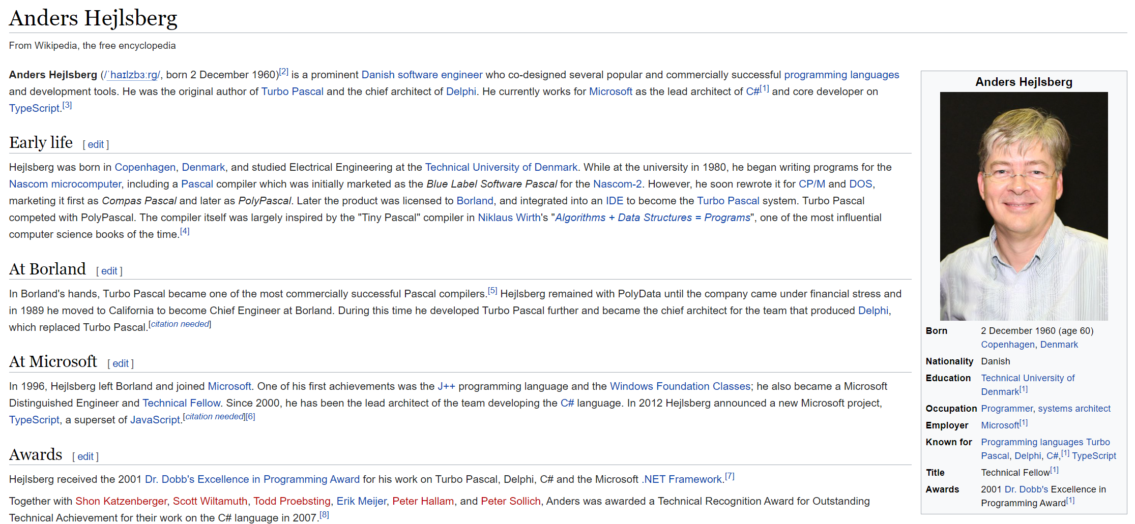

Slide 17
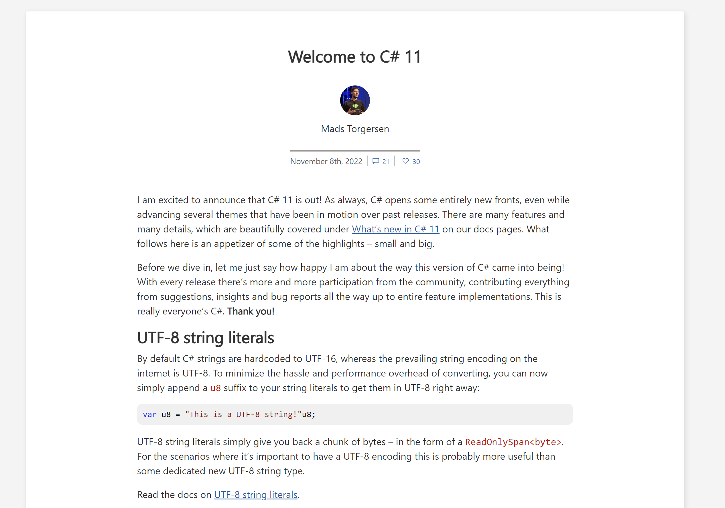

Slide 18
<PropertyGroup>
<TargetFramework>net7.0</TargetFramework>
<LangVersion>preview</LangVersion>
</PropertyGroup>

Slide 19
Pattern match Span on a constant string
ref fields and scoped ref
Generic Math Support
Required members
Auto-default structs
Raw String Literals
UTF-8 string literals
List Patterns
File-local types
Generic Attributes
Newlines in string interpolation expressions
Extended nameof scope
Numeric IntPtr
Warning wave 7

Slide 20
Auto-default struct
Compiler ensures that all fields of a struct type are initialized
public struct Statistic
{
public int Likes { get; set; }
public int Dislikes { get; set; }
public int Views { get; set; }
public Statistic(int dislikes, int views)
{
//Likes = likes;
Dislikes = dislikes;
Views = views;
}
}

Slide 21
Auto-default struct
Compiler ensures that all fields of a struct type are initialized
public struct Statistic
{
public int Likes { get; set; }
public int Dislikes { get; set; }
public int Views { get; set; }
public Statistic(int dislikes, int views)
{
//Likes = likes;
Dislikes = dislikes;
Views = views;
}
}
“Error CS0171 Field ‘Statistic.Likes’ must be fully assigned before control is returned to the caller.”

Slide 22
Raw String Literals
string line = "- Jan ate her friends sandwich.\n- Jan ate her friends colon.";
string punchline = """
- Jan ate her friends sandwich.
- Jan ate her friends colon.
""";

Slide 23
Pattern match Span<char>
Or ReadOnlySpan<char>
Test if a string had a specific constant value using pattern matching, but previous to C#11, you couldn’t test this on a span
public static string Language(this Joke j) {
ReadOnlySpan<char> language = j.Language.AsSpan();
var result = language switch
{
"NL" => "Dutch",
"EN" => "English",
"FR" => "French",
_ => "Unknown"
};
return result;
}

Slide 24
Extended nameof scope
Use this feature to specify the name of a method parameter
public string Author {
get => author;
set => author = value ?? throw new ArgumentNullException(
nameof(value),
$"{nameof(Author)} cannot be null");
}
app.MapGet("/jokes/type/{type/}language/{language}/",
[Log("type", nameof(type), nameof(language))] (string type, string language) =>
$"Joke: {type} in {language}!");

Slide 25
UTF-8 string literals
Specify UTF-8 character encoding by using u8 as the suffix of a string
byte[] bytes = Encoding.UTF8.GetBytes("Kevin DeRudder");
ReadOnlySpan<byte> span = "Kevin DeRudder"u8;
byte[] bytes = "Kevin DeRudder"u8.ToArray();
Notes:
he goal of that feature is to address particularly web scenarios where UTF-8 is king 👑. It is common to have string constants that need to be converted into UTF-8. In those scenarios, with previous versions, a developer would need to either pick performance or readability. Not anymore.
This proposal led to some backlash from the community. As you may know, .NET works with UTF-16 strings by default. Many were concerned that this would cause confusion.
Another concern was related to language evolution. What if one day, Mads Torgersen and his team need to get the representation of a UTF-16 into a byte array as well? You can see the problems that this uncovers.
Adding a new language feature is a balance of art, science and future prediction.

Slide 26
Init only setters
Syntax to initialize members of an object
More consistent syntax
public static void Run()
{
Joke j = new Joke() {
Setup = "There are types of people in this world...",
Punchline = "Those who understand binary and those who don’t”
};
j.Setup = "changes";
Console.WriteLine(j);
}
public class Joke {
public string Setup { get; init; }
public string Punchline { get; init; }
public override string ToString()
{
return $"{Setup} - {Punchline}";
}
}
Notes:
Init only setters provide consistent syntax to initialize members of an object. Property initializers make it clear which value is setting which property. The downside is that those properties must be settable. Starting with C# 9.0, you can create init accessors instead of set accessors for properties and indexers. Callers can use property initializer syntax to set these values in creation expressions, but those properties are readonly once construction has completed. Init only setters provide a window to change state. That window closes when the construction phase ends. The construction phase effectively ends after all initialization, including property initializers and with-expressions have completed.
You can declare init only setters in any type you write. For example, the following struct defines a weather observation structure:

Slide 27
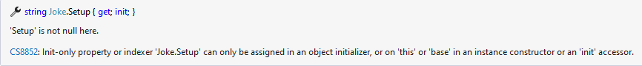
Init only setters
Syntax to initialize members of an object
More consistent syntax
public static void Run()
{
Joke j = new Joke() {
Setup = "There are types of people in this world...",
Punchline = "Those who understand binary and those who don’t”
};
j.Setup = "changes";
Console.WriteLine(j);
}
public class Joke {
public string Setup { get; init; }
public string Punchline { get; init; }
public override string ToString()
{
return $"{Setup} - {Punchline}";
}
}
Notes:
Init only setters provide consistent syntax to initialize members of an object. Property initializers make it clear which value is setting which property. The downside is that those properties must be settable. Starting with C# 9.0, you can create init accessors instead of set accessors for properties and indexers. Callers can use property initializer syntax to set these values in creation expressions, but those properties are readonly once construction has completed. Init only setters provide a window to change state. That window closes when the construction phase ends. The construction phase effectively ends after all initialization, including property initializers and with-expressions have completed.
You can declare init only setters in any type you write. For example, the following struct defines a weather observation structure:

Slide 28
required Members
required keyword that can apply to an instance property or an instance field declaration within a class, a record or a struct
This keyword forces the call to initialize the required field and property in the object initializer scope
public class Joke
{
public int Id { get; init; }
public string Setup { get; set; }
public required string Punchline { get; set; }
}

Slide 29
ref fields and ref scoped variables
Ref keyword indicates that a variable is passed by reference. Now, C# supports ref on a method argument or method return
int i = 10;
Foo(ref i);
ref int Foo(ref int j)
{
ref int k = ref i;
return ref j;
}
Notes:
Previous versions of C# brought us Span<T> that allow programmers to leverage direct memory access with the safety of GC-managed language. Unfortunately, it was using an internal type called ByReference<T> which means that we could leverage Span but we could not implement the Span equivalent ourselves.
n this example, the parameter j and local k are aliases for int i. When you get their values i is read, and when you set their values i is set. The compiler guards the scope. For example, you are allowed to return ref j because the compiler knows that the variable referred to by the parameter will still be in scope. The compiler would not allow you to return ref k because the local ref could point to stack memory that goes out of scope when the method returns.
As we've just covered, ref variables can point to stack memory, which implies strict scoping rules. ref variables can also point to heap memory, which is managed by the garbage collector (GC). Like variables that have reference types, the GC tracks ref variables.
C# 8 (.NET Core 2.1) introduced ref struct and used it to implement Span. The Span type is an abstraction for memory that is on either the stack or the heap. A ref struct can live only on the stack.
To represent memory, Span needs two fields: a ref field that points to the first element of the memory and a length field to store the length of the memory.
In previous versions of .NET, the Span implementation was handled internally by the runtime.
C# 11 introduces ref fields as a first-class language concept. This construct lets you describe your Span type and define your own ref structs that have ref fields. For example, you can create a type that is used to read information from a large struct that can be on the stack, be on the heap, or even be unmanaged memory:
https://developers.redhat.com/articles/2023/01/11/5-new-advanced-features-improving-c-11#ref_fields

Slide 30
File Local Types
Use file access modifier to create a type whose visibility is scoped to the source file
file record ResponseJoke
{
public int id { get; set; }
public string text { get; set; }
public bool is18Plus { get; set; }
public bool is12Plus { get; set; }
public string author { get; set; }
public string created { get; set; }
public string language { get; set; }
public string type { get; set; }
}

Slide 31
Generic Math Support
Was introduced in .NET 6
Use static abstract or static virtual members in interfaces to define interfaces that include:
Overloadable operators
Other static members
Static properties
Why
Mathematical operators in generic types
Notes:
Generic Math is a feature that Microsoft introduced in .NET 6, but now with the arrival of .NET 7 they have implemented many improvements and that is why we are going to talk about it. With Generic Math you can take full advantage of operators and static APIs by combining static virtuals and the power of generics.

Slide 32
Generic Math Support
C# 8
Generic interface + default interface methods
interface IKillable {
bool IsDeath { get; set; }
}
interface ILicenseToKill<T> where T : IKillable {
void Kill(T killableObject) {
killableObject.IsDeath = true;
}
}

Slide 33
Generic Math Support
int Sum(int a, int b) {
int result = 0;
result = a + b;
return result;
}

Slide 34
Generic Math Support
int Sum(int a, int b) {
int result = 0;
result = a + b;
return result;
}
int result = Sum(2, 3);

Slide 35
Generic Math Support
int Sum(int a, int b) {
int result = 0;
result = a + b;
return result;
}
int result = Sum(2, 3);
int result = Sum(2, 3.4);
int Add<T>(T a, T b)
{
int result =0;
result = a + b;
return result;
}

Slide 36
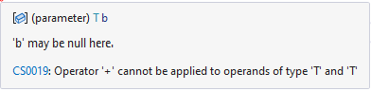
Generic Math Support
int Sum(int a, int b) {
int result = 0;
result = a + b;
return result;
}
int result = Sum(2, 3);
int result = Sum(2, 3.4);
int Add<T>(T a, T b)
{
int result =0;
result = a + b;
return result;
}

Slide 37
Generic Math Support
int Sum(int a, int b) {
int result = 0;
result = a + b;
return result;
}
int result = Sum(2, 3);
int result = Sum(2, 3.4);
int Add<T>(T a, T b)
{
int result =0;
result = a + b;
return result;
}

Slide 38
Generic Math Support
int Sum(int a, int b) {
int result = 0;
result = a + b;
return result;
}
int result = Sum(2, 3);
int result = Sum(2, 3.4);
T Add<T>(T a, T b)
{
int result =0;
result = a + b;
return result;
}

Slide 39
Generic Math Support
int Sum(int a, int b) {
int result = 0;
result = a + b;
return result;
}
int result = Sum(2, 3);
int result = Sum(2, 3.4);
using System.Numerics;
T Add<T>(T a, T b) where T : INumber<T>
{
T result = 0;
result = a + b;
return result;
}

Slide 40
Generic Math Support: INumber
public interface INumber<TSelf>
: IComparable,
IComparable<TSelf>,
IComparisonOperators<TSelf, TSelf, bool>,
IModulusOperators<TSelf, TSelf, TSelf>,
INumberBase<TSelf>
where TSelf : INumber<TSelf>?
public interface INumberBase<TSelf>
: IAdditionOperators<TSelf, TSelf, TSelf>,
IAdditiveIdentity<TSelf, TSelf>,
IDecrementOperators<TSelf>,
IDivisionOperators<TSelf, TSelf, TSelf>,
IEquatable<TSelf>,
IEqualityOperators<TSelf, TSelf, bool>,
IIncrementOperators<TSelf>,
IMultiplicativeIdentity<TSelf, TSelf>,
IMultiplyOperators<TSelf, TSelf, TSelf>,
ISpanFormattable,
ISpanParsable<TSelf>,
ISubtractionOperators<TSelf, TSelf, TSelf>,
IUnaryPlusOperators<TSelf, TSelf>,
IUnaryNegationOperators<TSelf, TSelf>
where TSelf : INumberBase<TSelf>?

Slide 41
Generic Math Support: INumber
/// <summary>Defines a mechanism for computing the sum of two values.</summary>
/// <typeparam name="TSelf">The type that implements this interface.</typeparam>
/// <typeparam name="TOther">The type that will be added to <typeparamref name="TSelf" />.</typeparam>
/// <typeparam name="TResult">The type that contains the sum of <typeparamref name="TSelf" /> and <typeparamref name="TOther" />.</typeparam>
public interface IAdditionOperators<TSelf, TOther, TResult>
where TSelf : IAdditionOperators<TSelf, TOther, TResult>?
{
/// <summary>Adds two values together to compute their sum.</summary>
/// <param name="left">The value to which <paramref name="right" /> is added.</param>
/// <param name="right">The value which is added to <paramref name="left" />.</param>
/// <returns>The sum of <paramref name="left" /> and <paramref name="right" />.</returns>
static abstract TResult operator +(TSelf left, TOther right);
/// <summary>Adds two values together to compute their sum.</summary>
/// <param name="left">The value to which <paramref name="right" /> is added.</param>
/// <param name="right">The value which is added to <paramref name="left" />.</param>
/// <returns>The sum of <paramref name="left" /> and <paramref name="right" />.</returns>
/// <exception cref="OverflowException">The sum of <paramref name="left" /> and <paramref name="right" /> is not representable by <typeparamref name="TResult" />.</exception>
static virtual TResult operator checked +(TSelf left, TOther right) => left + right;
}

Slide 42
List Patterns
Discard pattern
Range pattern
Constant pattern
Var pattern
Case pattern
https://thecodeblogger.com/2022/09/19/c-11-introducing-list-patterns-matching/

Slide 43
Native-sized integers
Integer which size is specific to the platform
Integer that wil have a range and size compliant with the ‘word size’ on the cpu the architecture is running on
Software running as a 32-bit process, they will be 32-bit in size and range
Software running as a 64-bit process, they will be 64-bit in size and range
Easier to write interop code that talks to other libraries that are written for those 32-bit/64-bit CPUs
Now you can use them as integers instead of IntPtr for these purposes

Slide 44
Native-size integers
public static void Main(string[] args)
{
nint x = 3;
int y = 3;
long v = 10;
nint.Equals(x, y); // False
nint.Equals(x, (nint)y); // True
var test1 = y + 1 > x; // True;
var test2 = y - 1 == x; // False
var test3 = typeof(nint); // System.IntPtr
var test4 = typeof(nuint); // System.UIntPtr
var test5 = (x + 1).GetType(); // System.IntPtr
var test6 = (x + y).GetType(); // System.IntPtr
var test7 = (x + v).GetType(); // System.Int64
}

Slide 45

Records
Main purpose of storing data
9
Define a reference type
Built-in functionality for encapsulation
Immutable properties
Difference with a class
Records are immutable, classes are mutable

Slide 46
Records
public record DadJokeDto(long id, string Setup, string Punchline);

Slide 47
Positional Syntax
9
Declare and initialize property values of an instance
Compiler makes the properties init-only auto-implemented
Compiler creates constructor accepting values and assigns to properties
public static void Run()
{
Joke j = new Joke("There are types of people in this world...",
"Those who understand binary and those who don't");
Console.WriteLine(j);
}
public record Joke(string Setup, string Punchline);
Creates a joke record and initializes the init-only properties without an explicit constructor

Slide 48

Positional Syntax
9
Declare and initialize property values of an instance
Compiler makes the properties init-only auto-implemented
Compiler creates constructor accepting values and assigns to properties
What if I don’t want the
auto-implementation
public static void Run()
{
Joke j = new Joke("There are types of people in this world...",
"Those who understand binary and those who don't");
Console.WriteLine(j);
}
public record Joke(string Setup, string Punchline);
Creates a joke record and initializes the init-only properties without an explicit constructor

Slide 49
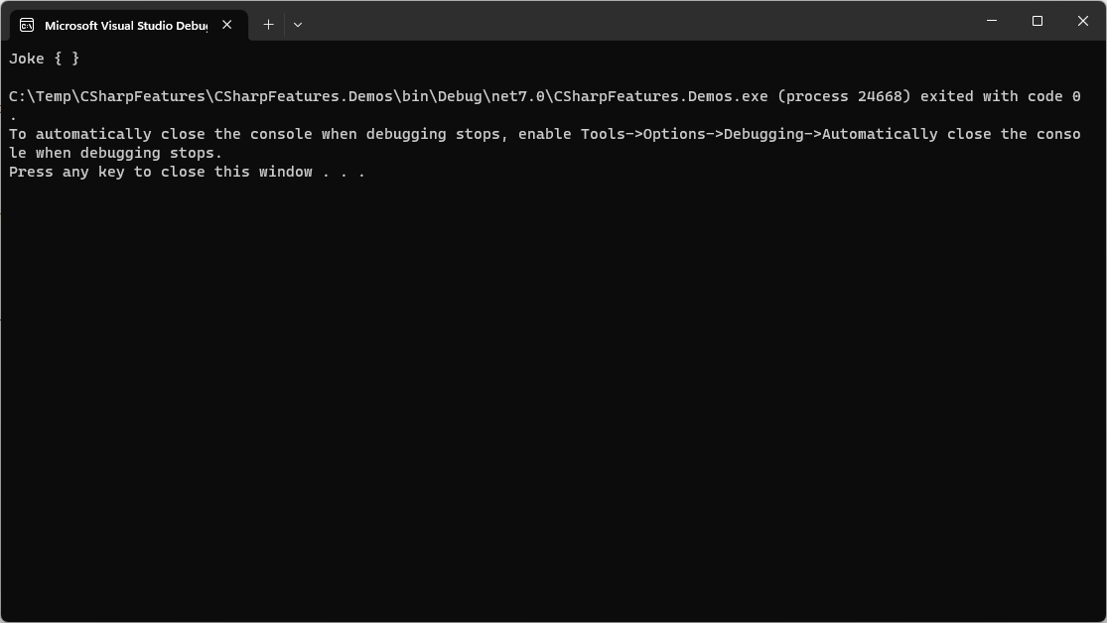
public static void Run()
{
Joke j = new Joke("There are types of people in this world...",
"Those who understand binary and those who don't");
Console.WriteLine(j);
}
public record Joke(string Setup, string Punchline) {
protected string Setup { get; init; } = Setup;
protected string Punchline { get; init; } = Punchline;
}

Slide 50
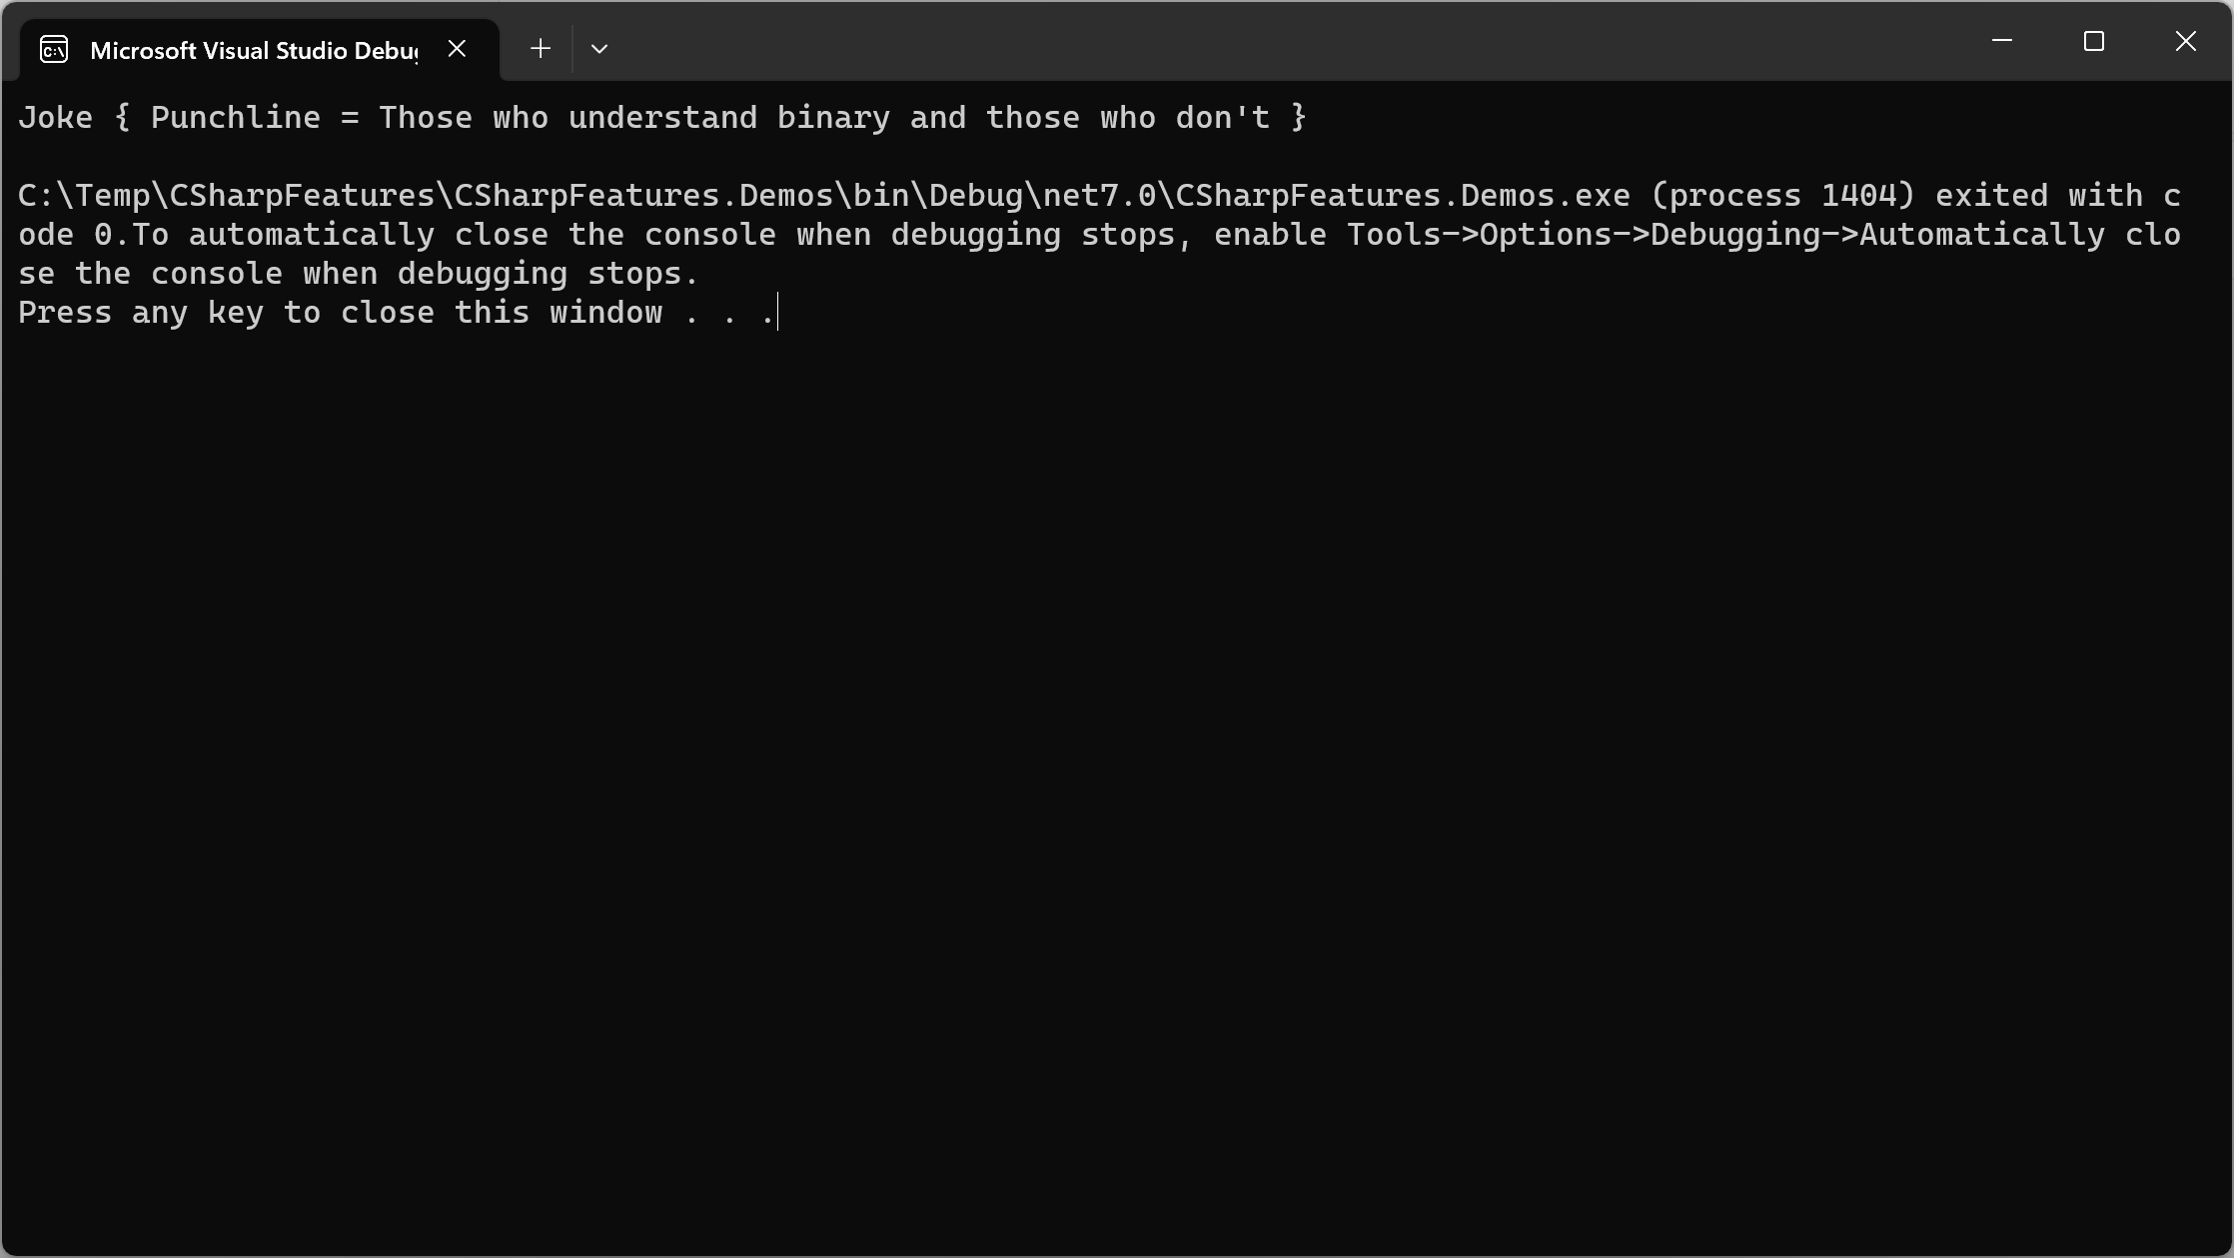
public static void Run()
{
Joke j = new Joke("There are types of people in this world...",
"Those who understand binary and those who don't");
Console.WriteLine(j);
}
public record Joke(string Setup, string Punchline) {
protected string Setup { get; init; } = Setup;
}

Slide 51
Interpolated string handler

Slide 52
@kevinderudder
: freelance fullstack developer
: trainer and coach
:

